Slide 1
Lecture 4
Properties Of Fluids-Cont.
By Dr. Mohamed Fekry
2 ^{nd} Sem.1434

Slide 2
Properties Of Fluids
Density (ρ) and Specific Volume (v)
Specific Gravity (SG)
Specific Weight (γ)
Density of ideal gas
Coefficient of Compressibility (k)
Coefficient of Volume Expansion (β)
Viscosity (μ)
Surface Tension (σ)&
Capillary Effect (h)

Slide 3
Heat
“…is a form of energy transfer across a boundary of a system at a given temperature to another system (or the surroundings) at lower temperature by virtue of the temperature difference between the two systems”
Sign convention for heat:
positive - added to the system
negative - removed from the system

Slide 4
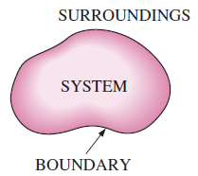
Useful definitions
A system is defined as a quantity of matter or a region in space chosen for study. The mass or region outside the system is called the surroundings. The real or imaginary surface that separates the system from its surroundings is called the boundary. The boundary of a system can be fixed or movable.

Slide 5
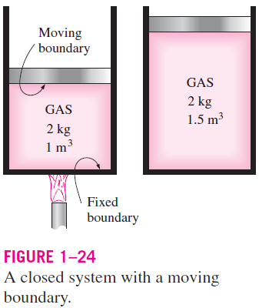
Systems may be considered to be closed or open, depending on whether a fixed mass or a volume in space is chosen for study. A closed system (also known as a control mass) consists of a fixed amount of mass, and no mass can cross its boundary.

Slide 6
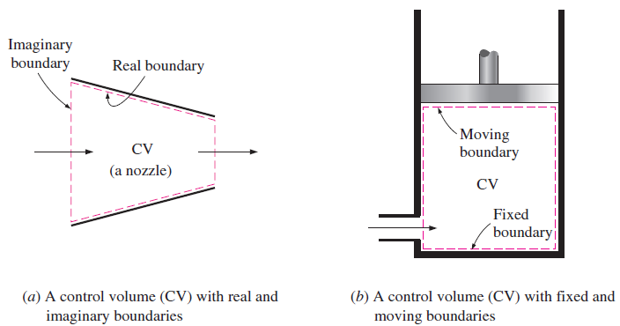
An open system, or a control volume, as it is often called, is a properly selected region in space. It usually encloses a device that involves mass flow such as a compressor, turbine, or nozzle. Flow through these devices is best studied by selecting the region within the device as the control volume. Both mass and energy can cross the boundary of a control volume.

Slide 7
Pressure
“… is a force per unit area exerted by the fluid”
is pressure a stress?
unit: Pa, bar, atm or psi?
use: absolute, gauge or vacuum pressure?
manometer or barometer?
Units of measuring pressure
Atmosphere | bar | psi | Kpa | m -Water | cm Hg | Kg_{f}/cm²
1 | 1.01325 | 14.696 | 101.325 | 1.034 | 76 | 1.03322

Slide 9
VAPOR PRESSURE AND CAVITATION
Temperature and pressure are dependent properties for pure substances during phase-change processes, and there is one-to-one correspondence between temperatures and pressures.
At a given pressure, the temperature at which a pure substance changes phase is called the saturation temperature T_{sat}.
At an absolute pressure of 1 standard atmosphere (1 atm or 101.325 kPa), for example, the saturation temperature of water is 100°C.
The vapor pressure P_{v} of a pure substance is defined as the pressure exerted by its vapor in phase equilibrium with its liquid at a given temperature. P_{v} is a property of the pure substance, and turns out to be identical to the saturation pressure P_{sat} of the liquid or
P_{v} = P_{sat}

Slide 10
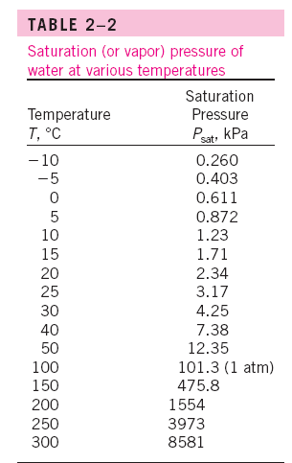
EXAMPLE 2–2
Minimum Pressure to Avoid Cavitation
In a water distribution system, the temperature of water is observed to be as
high as 30°C. Determine the minimum pressure allowed in the system to
avoid cavitation.
Solution: The minimum pressure in a water distribution system to avoid
cavitation is to be determined.
Properties: The vapor pressure of water at 30°C is 4.25 kPa.
Analysis: To avoid cavitation, the pressure anywhere in flow should not be
allowed to drop below the vapor (or saturation) pressure at the given temperature.
That is,
Pmin = Psat@30C = 4.25 kPa

Slide 11
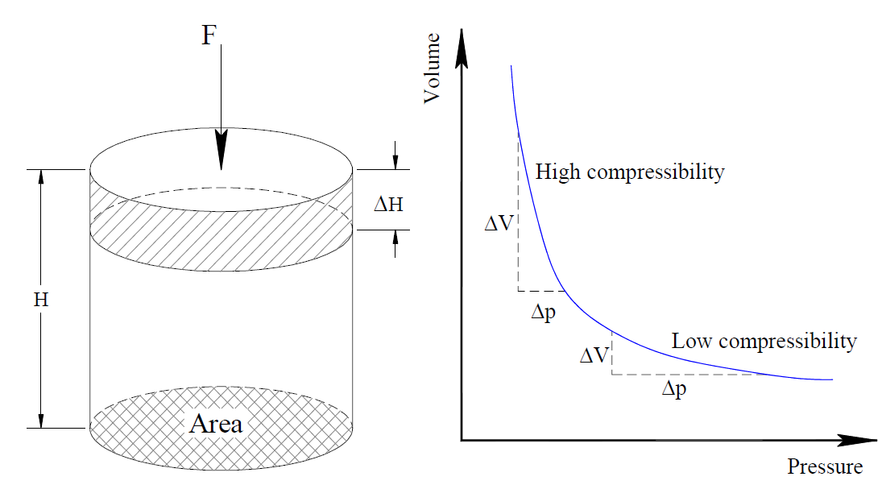
Coefficient of Compressibility (k)
Compressibility reflects the stress-strain properties of a material:
Stress: internal response of a material to an external pressure
Strain: measure of the linear or volumetric deformation of a stressed material

Slide 12
Compressibility (change in volume due to change in pressure) is inversely proportional to its volume modulus of elasticity (Bulk Modulus of Elasticity)
Where:
ΔV = Change in volume
Δp = Change in pressure
k = must have the dimension of pressure (Pa or psi).
the coefficient of compressibility of a truly incompressible substance (v constant) is infinity

Slide 13
A large value of k indicates that a large change in pressure is needed to cause a small fractional change in volume, and thus a fluid with a large k is essentially incompressible.
Small density changes in liquids can still cause interesting phenomena in piping systems such as the water hammer—characterized by a sound that resembles the sound produced when a pipe is “hammered.”
This occurs when a liquid in a piping network encounters an abrupt flow restriction (such as a closing valve) and is locally compressed. The acoustic waves produced strike the pipe surfaces, bends, and valves as they propagate and reflect along the pipe, causing the pipe to vibrate and produce the familiar sound.

Slide 14
That is, the fractional changes in the specific volume and the density of a fluid are equal in magnitude but opposite in sign.

Slide 16
Coefficient of Volume Expansion (β)
- The density of a fluid, in general, depends more strongly on temperature than it does on pressure, in turn , we need a property that represents the variation of the density of a fluid with temperature at constant pressure.
- The property that provides that information is the coefficient of volume expansion (or volume expansivity) β, and defined as

Slide 17
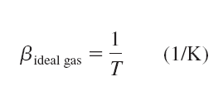
For an ideal gas The volume expansion coefficient at a temperature T is equivalent to the inverse of the temperature:
where T is the absolute temperature.

