Slide 1

HUMAN RESOURCE MANAGEMENT
Global Edition 12e
Chapter 4
Ethics, Justice, And Fair Treatment in HR Management
Part 5 Employee Relations
Copyright © 2011 Pearson Education
GARY DESSLER
PowerPoint Presentation by Charlie Cook
The University of West Alabama
Notes:
Human Resources Management 12e
Gary Dessler
Copyright © 2011 Pearson Education
1–1

Slide 2

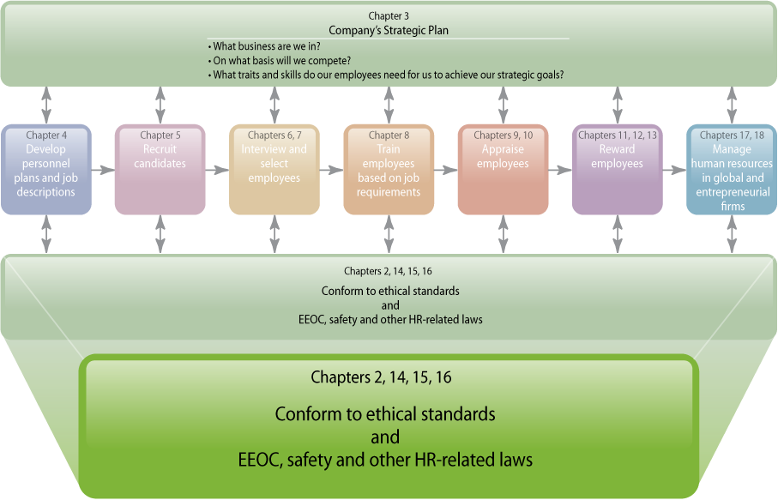
WHERE WE ARE NOW…
Notes:
In Part 5 we turn to employee justice, safety, and union relations. The main purpose of Chapter 14 is to explain ethics, justice, and fair treatment in human resource management, matters essential for positive employee relations. Topics include ethics and fair treatment at work, factors that shape ethical behavior at work, and managers’ roles in fostering improved workplace ethics, employee discipline, and dismissals.

Slide 3
LEARNING OUTCOMES
Explain what is meant by ethical behavior at work.
Discuss important factors that shape ethical behavior at work.
Describe at least four specific ways in which HR management can influence ethical behavior at work.
Employ fair disciplinary practices.
List at least four important factors in managing dismissals effectively.

Slide 4
Ethics and Fair Treatment at Work
The Meaning of Ethics
  The principles of conduct governing an individual or a group.
  The standards you use to decide what your conduct should be.
  Ethical behavior depends on
  a person’s frame of reference.
Ethical Decisions
  Normative judgments
  Morality
Notes:
“Why include ethics in a human resource management book?” For two reasons: First, ethics is not theoretical. Instead, it greases the wheels that make businesses work.
Second, and more specifically, managers’ human resource decisions are usually replete with ethical consequences.

Slide 5
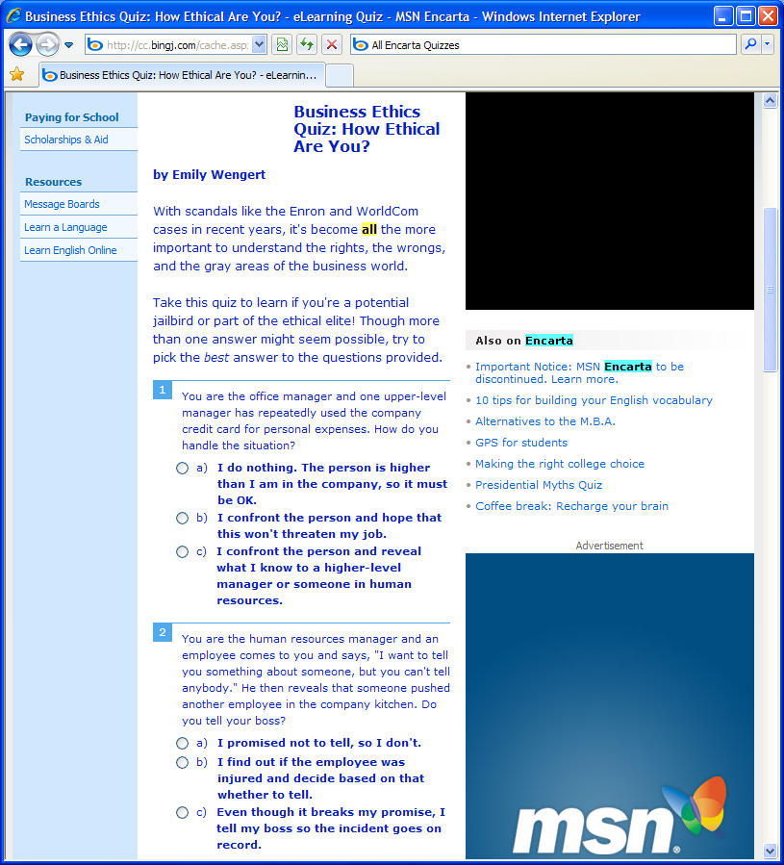
FIGURE 14–1
Online Ethics Quiz
Notes:
People face ethical choices every day. Is it wrong to use a company credit card for personal purchases? Is a $50 gift to a client unacceptable? Compare your answers by answering the online quiz in Figure 14-1.

Slide 6

TABLE 14–1 Specific Observed Unethical Behaviors
Abusive or intimidating behavior toward employees 21%
Lying to employees, customers, vendors, or to the public 19%
A situation that places employee interests over organizational interests 18%
Violations of safety regulations 16%
Misreporting of actual time worked 16%
E-mail and Internet abuse 13%
Discrimination on the basis of race, color, gender, age, or similar categories 12%
Stealing or theft 11%
Sexual harassment 9%
Provision of goods or services that fail to meet specifications 8%
Misuse of confidential information 7%
Alteration of documents 6%
Falsification or misrepresentation of financial records or reports 5%
Improper use of competitors’ inside information 4%
Price fixing 3%
Giving or accepting bribes, kickbacks, or inappropriate gifts 3%
Notes:
Table 14-1 lists the percentage of employees observing various unethical behaviors at work.

Slide 7
Ethics and the Law
A behavior may be legal
but unethical.
A behavior may be illegal but ethical.
Ethics and
Behaviors
A behavior may be both legal and ethical.
A behavior may be both illegal and unethical.
Notes:
Legal behavior isn’t always ethical and ethical behavior sometimes may not be legal. For example, the civil rights movement challenged legalized segregation with civil disobedience behaviors that resulted in a societal change in legal and ethical attitudes toward the legality of discrimination.

Slide 8
Ethics, Fair Treatment, and Justice
Components of Organizational Justice
Distributive justice
Procedural justice
Notes:
Fairness is inseparable from what most people think of as “justice.” A company that is just is, among other things, equitable, fair, impartial, and unbiased in how it does things. With respect to employee relations, experts generally define organizational justice in terms of at least two components—distributive justice and procedural justice.
In theory, ethics, justice, and fair treatment may be separate but related concepts. But in practice most employees probably can’t and won’t unscramble what is ethical, fair, or just when it comes to how they’re treated at work.

Slide 9
FIGURE 14–2 Perceptions of Fair Interpersonal Treatment Scale
What is your organization like most of the time? Circle Yes if the item describes your organization,
No if it does not describe your organization, and ? if you cannot decide.
IN THIS ORGANIZATION:
1. Employees are praised for good work | Yes | ? | No
2. Supervisors yell at employees (R) | Yes | ? | No
3. Supervisors play favorites (R) | Yes | ? | No
4. Employees are trusted | Yes | ? | No
5. Employees’ complaints are dealt with effectively | Yes | ? | No
6. Employees are treated like children (R) | Yes | ? | No
7. Employees are treated with respect | Yes | ? | No
8. Employees’ questions and problems are responded to quickly | Yes | ? | No
9. Employees are lied to (R) | Yes | ? | No
10. Employees’ suggestions are ignored (R) | Yes | ? | No
11. Supervisors swear at employees (R) | Yes | ? | No
12. Employees’ hard work is appreciated | Yes | ? | No
13. Supervisors threaten to fire or lay off employees (R) | Yes | ? | No
14. Employees are treated fairly | Yes | ? | No
15. Coworkers help each other out | Yes | ? | No
16. Coworkers argue with each other (R) | Yes | ? | No
17. Coworkers put each other down (R) | Yes | ? | No
18. Coworkers treat each other with respect | Yes | ? | No
Note: R = the item is reverse scored.
Notes:
Figure 14-2 lists concrete actions that employees perceive are fair or unfair interpersonal treatments that occur in their organization.

Slide 10
FIGURE 14–3 Some Areas Under Which Workers Have Legal Rights
Leave of absence and vacation rights Injuries and illnesses rights Noncompete agreement rights Employees’ rights on employer policies Discipline rights Rights on personnel files Employee pension rights Employee benefits rights References rights Rights on criminal records | Employee distress rights Defamation rights Employees’ rights on fraud Rights on assault and battery Employee negligence rights Right on political activity Union/group activity rights Whistleblower rights Workers’ compensation rights
Notes:
Figure 14-3 lists some other legislated areas under which workers have legislated rights. Aside from legislation, employees also have certain rights under common law.

Slide 11
What Influences Ethical Behavior At Work?
Ethical behavior starts with moral awareness.
Managers strongly influence ethics by carefully cultivating the right norms, leadership, reward systems, and culture.
Ethics slide when people undergo moral disengagement.
The most powerful morality comes from within.
Beware of the seductive power of an unmet goal.
Offering rewards for ethical behavior can backfire.
Don’t inadvertently reward someone for bad behavior.
Employers should punish unethical behavior.
The degree to which employees openly talk about ethics
is a good predictor of ethical conduct.
People tend to alter their moral compasses when
they join organizations.
Notes:
Several experts have reviewed the research concerning things that influence ethical behavior in organizations and here’s what they found.

Slide 12
What Determines Ethical Behavior at Work?
Individual
Factors
Organizational Culture
Organizational Factors
Ethical Work Behaviors
Ethical Policies
and Codes
The Boss’s Influence
Notes:
Several things determine an individual employee’s ethical behavior at work.

Slide 13
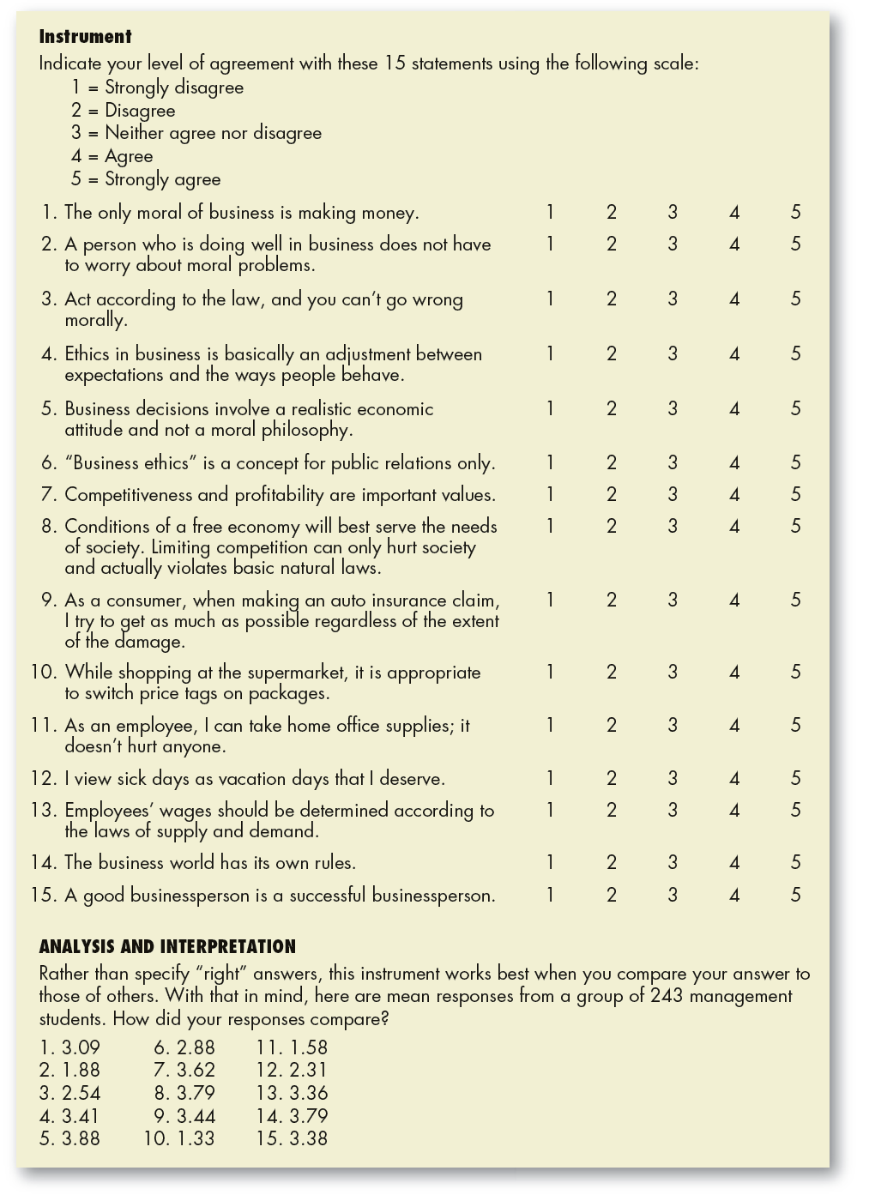
FIGURE 14–4
How Do My
Ethics Rate?
Notes:
Figure 14-4 presents a short self-assessment survey to help you rate your own ethics.

Slide 14
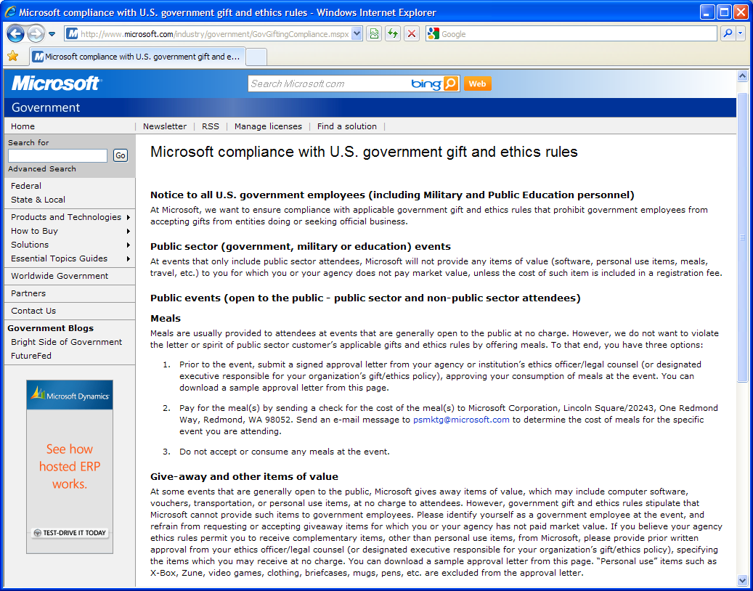
FIGURE 14–5 Using the Company Web site to Emphasize Ethics
Notes:
Figure 14-5 is an example of how employers can emphasize ethics before an applicant even applies for a job with the firm.

Slide 15
What Is Organizational Culture?
Organizational Culture
  The characteristic values, traditions, and
  behaviors a firm’s employees share
How Managers Can Support an Ethical Culture
  Clarifying expectations with respect to critical values
  “Walking the talk” in having their actions align with values
  Providing physical support through the use of ethical managerial values
Notes:
We can define organizational culture as the “characteristic values, traditions, and behaviors a company’s employees share.” A value is a basic belief about what is right or wrong, or about what you should or shouldn’t do.

Slide 16
The Boss’s Influence on Ethical Behavior
Telling staffers to do whatever is necessary to achieve results
Leading Employees Astray
Overloading top performers to ensure that the work gets done
Looking the other way when wrongdoing occurs
Taking credit for others’ work or shifting blame
Notes:
Here are examples of how supervisors knowingly (or unknowingly) can lead subordinates astray.

Slide 17
TABLE 14–2 Principal Causes of Ethical Compromises
 | Senior Mgmt. | Middle Mgmt. | Front-Line Supv. | Prof. Non- Mgmt. | Admin. Salaried | Hourly
Meeting schedule pressure | 1 | 1 | 1 | 1 | 1 | 1
Meeting overly aggressive financial or business objectives | 3 | 2 | 2 | 2 | 2 | 2
Helping the company survive | 2 | 3 | 4 | 4 | 3 | 4
Advancing the career interests of my boss | 5 | 4 | 3 | 3 | 4 | 5
Feeling peer pressure | 7 | 7 | 5 | 6 | 5 | 3
Resisting competitive threats | 4 | 5 | 6 | 5 | 6 | 7
Saving jobs | 9 | 6 | 7 | 7 | 7 | 6
Advancing my own career or financial interests | 8 | 9 | 9 | 8 | 9 | 8
Other | 6 | 8 | 8 | 9 | 8 | 9
Note: 1 is high, 9 is low.
Notes:
Table 14-2 summarizes the results of one survey. It shows the principal causes of ethical lapses, as reported by six levels of employees and managers. As you can see, being under the gun to meet scheduling pressures was the number-one reported factor.

Slide 18
Fostering Ethical Work Behaviors
What Employers Can Do
Provide manager and employee ethics training
Establish whistleblower policies
Adopt a strong ethics code
Notes:
Managers have to send the right signals to their employees. Guidelines for what employers can do are included in this slide.

Slide 19
Employees and Ethical Dilemmas
Questions employees should ask when faced with ethical dilemmas:
  Is the action legal?
  Is it right?
  Who will be affected?
  Does it fit the company’s values?
  How will it “feel” afterwards?
  How will it look in the newspaper?
  Will it reflect poorly on the company?
Notes:
Some companies urge employees to apply a quick ethics test to evaluate whether what they’re about to do fits the company’s code of conduct.

Slide 20
How Managers Use Personnel Methods To Promote Ethics and Fair Treatment
HRM Practices that Promote Ethics
Emphasizing ethics and fairness in personnel selection
Providing mandatory employee ethics training
Ensuring fair and objective performance appraisals
Disciplining
all instances
of unethical conduct
Notes:
Many of the actions managers can take to promote ethics fall within the realm of human resource management practices.

Slide 21
HRM-Related Ethics Activities
Selection
  Fostering the perception of fairness in the processes
  of recruitment and hiring of people:
    Formal hiring procedures that test job competencies
    Respectful interpersonal treatment of applicants
    Feedback provided to applicants
Training Employees
  How to recognize ethical dilemmas
  How to use ethical frameworks to resolve problems
  How to use HR functions in ethical ways
Notes:
Managers interviewing applicants also need to make sure the screening process is fair.
For all practical purposes, ethics training is mandatory. Federal sentencing guidelines reduced penalties for employers accused of misconduct who implemented codes of conduct and ethics training.

Slide 22
HRM-Related Ethics Activities (cont’d)
Performance Appraisal
  Appraisals that make it clear that the company adheres to high ethical standards by measuring and rewarding employees who follow those standards.
    Standards are clearly defined.
    Employees understand the basis for appraisals.
    Appraisals are objective.
Reward and Disciplinary Systems
  The organization swiftly and harshly punishes unethical conduct.
Notes:
To send the signal that fairness is paramount, standards should be clear, employees should understand the basis upon which they will be appraised, and the appraisal itself should be objective.
To the extent that behavior is a function of its consequences, the manager needs to reward ethical behavior and penalize unethical behavior.

Slide 23
HRM-Related Ethics Activities (cont’d)
HR’s Ethics Compliance Activities
  Complying with the Sarbanes-Oxley Act of 2002
    Requires that CEOs and CFOs of publicly traded companies personally attest to accuracy of their companies’ financial statements and that their internal controls are adequate.
    Increased the need for ethics training and verification of training.
  Firms are using online ethics training programs to comply with the act’s requirements.
Notes:
Passage of the Sarbanes-Oxley Act of 2002 has made ethics compliance obligatory.

Slide 24
Fostering Employees’
Perceptions of Fairness
Perceptions of fair treatment depend on:
Involvement in decisions
Understanding through explanation
Setting expectations and standards
Notes:
What seems “fair” to one person may seem unfair to another. Supervisory actions do influence employees’ perceptions of fairness.

Slide 25
Managing Employee Discipline
Fair and Just Discipline Process
Clear rules
and regulations
A system of progressive penalties
A formal unbiased
appeals process
Notes:
The employer wants its discipline process to be both effective (in terms of discouraging unwanted behavior) and fair. Employers base such a process on three pillars: clear rules and regulations, a system of progressive penalties, and an appeals process.

Slide 26
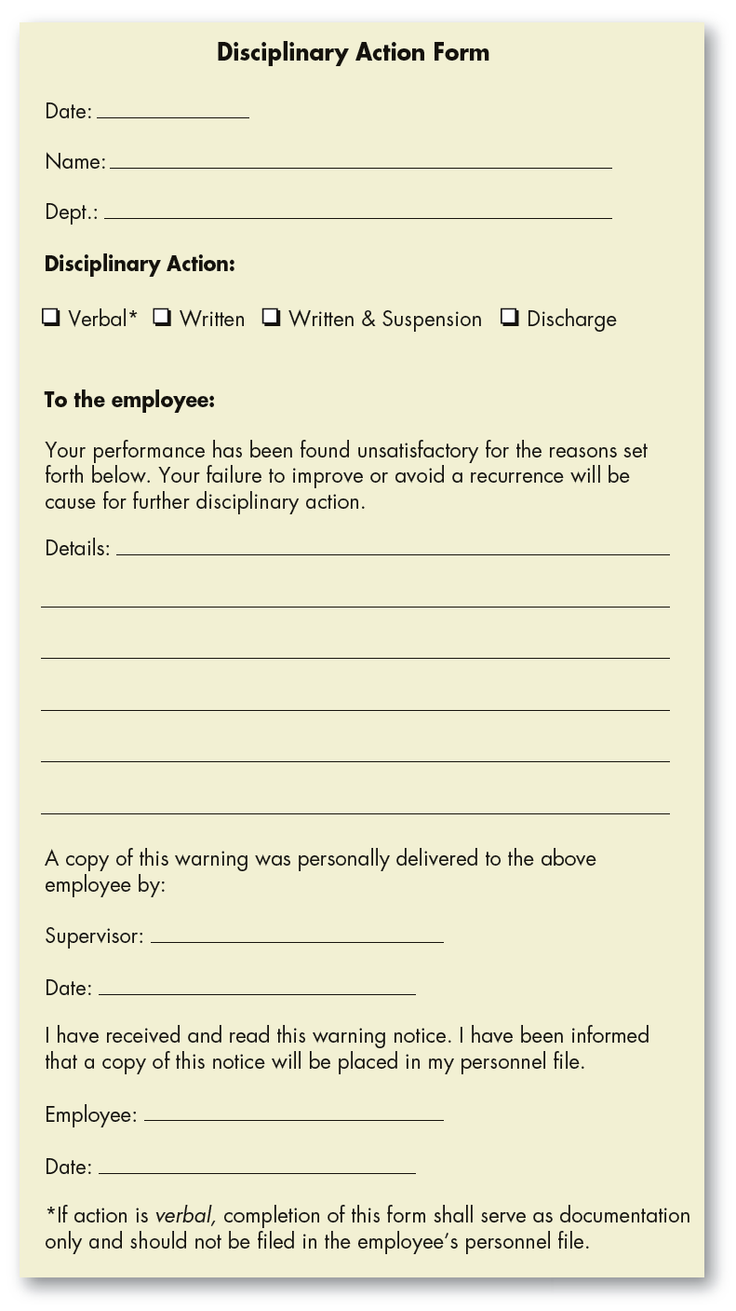
FIGURE 14–7
Disciplinary
Action Form
Notes:
Figure 14-7 is a sample form that a firm would use to issue a disciplinary warning to an employee.

Slide 27
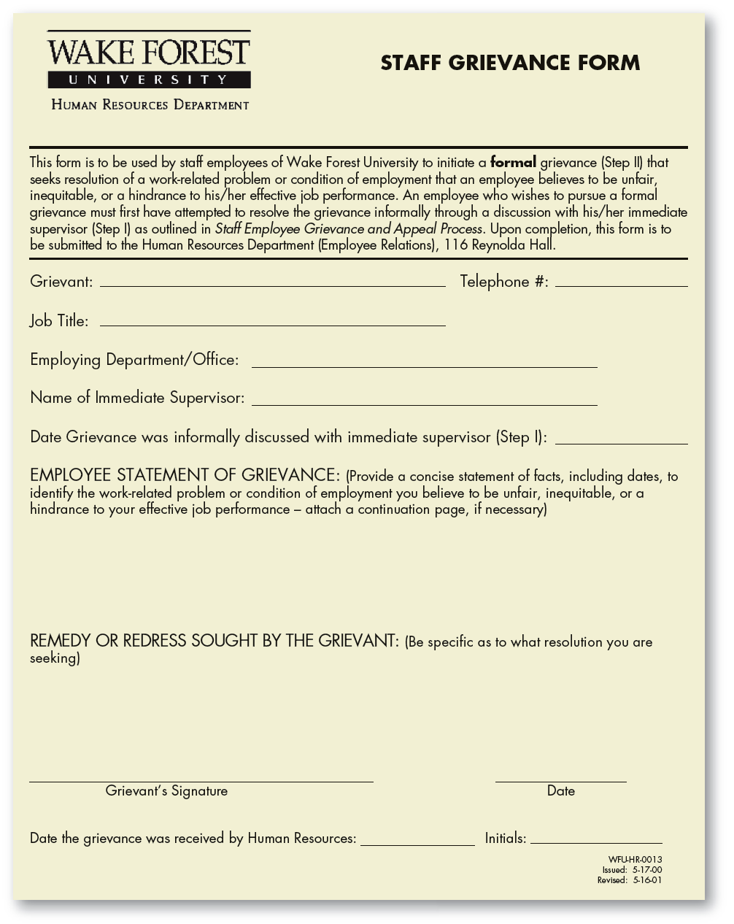
FIGURE 14–8
Grievance Form as Part of the Appeal Process
Notes:
Figure 14-8 is a grievance form that is used in the appeals procedure for a disciplinary process.

Slide 28
Formal Disciplinary Appeals Processes
FedEx's Multi-Step Guaranteed Fair Treatment Program
  Step 1: Management review
  Step 2: Officer complaint
  Step 3: Executive appeals review
Notes:
Virtually all union agreements contain disciplinary appeal procedures, but such procedures are not limited to unionized firms. For example, FedEx calls its 3-step appeals procedure guaranteed fair treatment.

Slide 29
Discipline Without Punishment
(Nonpunitive Discipline)
Issue an oral reminder.
Should another incident arise within six weeks, issue a formal written reminder, a copy of which is placed in the employee’s personnel file.
Give a paid, one-day “decision-making leave.”
If no further incidents occur in the next year, then purge the one-day paid suspension from the person’s file. If the behavior is repeated, the next step is dismissal.
Notes:
Discipline without punishment (or nonpunitive discipline) aims to avoid the drawbacks of punitive discipline. It does this by gaining employees’ acceptance of the rules while reducing the punitive nature of the discipline itself.

Slide 30
FIGURE 14–9 Summary of Fair Discipline Guidelines
Make sure the evidence supports the charge.
Make sure the employee’s due process rights are protected.
Warn the employee of the disciplinary consequences.
Determine if the rule that was allegedly violated should be “reasonably related”
to the efficient and safe operation of the work environment.
Investigate fairly and adequately the matter before administering discipline.
Conduct an investigation sufficient to uncover any substantial evidence of misconduct.
Apply all rules, orders, or penalties evenhandedly.
Apply a penalty that is reasonably related to the misconduct and
to the employee’s past work.
Maintain the employee’s right to counsel.
Don’t rob a subordinate of his or her dignity.
Remember that the burden of proof is on you.
Get the facts. Don’t base a decision on hearsay or on your general impression.
Don’t act while angry.
In general, do not attempt to deal with an employee’s “bad attitude.”
Focus on improving the specific behaviors creating the workplace problem.
Notes:
Figure 14-9 summarizes some useful fair discipline guidelines.

Slide 31
Employee Privacy
Employee privacy violations upheld by courts:
  Intrusion or surveillance
  Publication of private matters
  Disclosure of medical records
  Appropriation of an employee’s name or likeness
Actions triggering privacy violations:
  Background checks
  Monitoring off-duty conduct and lifestyle
  Drug testing
  Workplace searches
  Monitoring of workplace
Notes:
For most people, invasions of privacy are neither ethical nor fair. Employers must take care when engaging in these activities to avoid triggering privacy violations.

Slide 32
Employee Monitoring
What Is Monitored:
  Identity verification
  Location
  E-mail activity and Internet use
  Telephone calls
Why Employers Monitor:
  To guard against liability for illegal acts and harassment suits caused by employee misuse
  To improve productivity
  To detect leaks of confidential information
  To protect against computer viruses
Notes:
Monitoring of employees is a widespread workplace occurrence that employers do to improve employee productivity and to protect themselves.

Slide 33
Restrictions on Workplace Monitoring
The Electronic Communications Privacy Act (ECPA)
  Restricts employer interception
  and monitoring of oral and wire communications
    “business purpose exception”
    “consent exception”
Common law
  Provides protections against invasion of privacy
Notes:
There are two main restrictions on workplace monitoring: the Electronic Communications Privacy Act (ECPA) and common-law protections against invasion of privacy. The ECPA is a federal law intended to help restrict interception and monitoring of oral and wire communications.
Federal law and most state laws allow employers to monitor employees’ phone calls in the ordinary course of business, but they must stop listening once it becomes clear that a conversation is personal rather than business related.

Slide 34
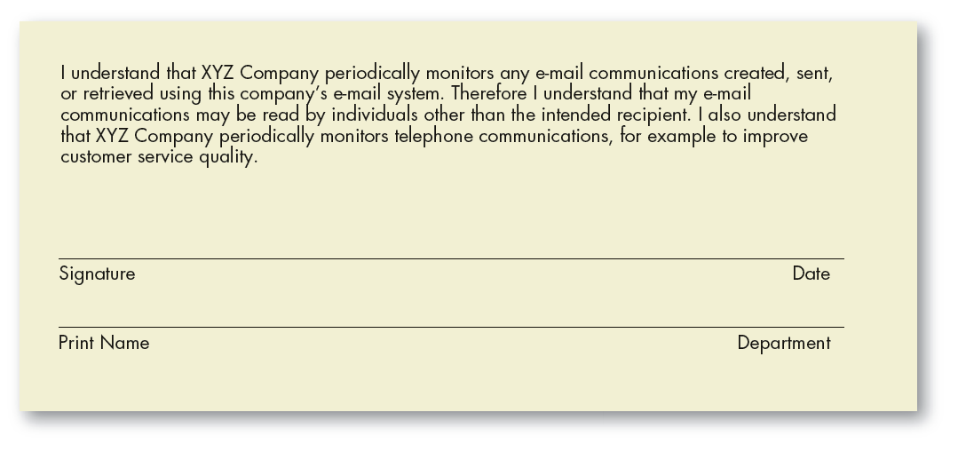
FIGURE 14–10 Sample E-Mail Monitoring Acknowledgment Statement
Notes:
One recent U.S. Court of Appeals case suggests employers may have fewer rights to monitor e-mail than previously assumed. Employers should have employees sign e-mail and telephone monitoring acknowledgment statements like that in Figure 14-10.

Slide 35
Managing Dismissals
Dismissal
  Involuntary termination of an employee’s employment
  with the firm.
Terminate-at-Will Rule
  Without a contract, the employee can resign for any reason, at will, and the employer can similarly dismiss the employee for any reason (or no reason), at will.
Wrongful Discharge
  An employee dismissal that does not comply with the law or does not comply with the contractual arrangement stated or implied by the firm via its employment application forms, employee manuals, or other promises.
Notes:
Dismissal is the most drastic disciplinary step the employer can take. Because of this, it requires special care. There should be sufficient cause for the dismissal, and (as a rule) you should only dismiss someone after taking reasonable steps to rehabilitate or salvage the employee. However, there will undoubtedly be times when dismissal is required, perhaps at once.
Termination at will means that without a contract, either the employer or the employee could terminate at will the employment relationship. The employee can resign for any reason, at will, and the employer can dismiss an employee for any reason, at will.
Wrongful discharge is the dismissal of an employee that does not comply with the law or does not comply with the contractual arrangement stated or implied by the firm via its employment application forms, employee manuals, or other promises.

Slide 36
Managing Dismissals (cont’d)
Protections Against Wrongful Discharge
Statutory exceptions
Common law exceptions
Public policy exceptions
Notes:
Wrongful discharge refers to a dismissal that violates the law or that fails to comply with contractual arrangements stated or implied by the employer, for instance, in employee manuals. Three main protections against wrongful discharge have eroded the termination-at-will doctrine—statutory exceptions, common law exceptions, and public policy exceptions.

Slide 37
Grounds for Dismissal
Unsatisfactory performance
Misconduct
Bases for Dismissal
Lack of qualifications
Changed requirements of (or elimination of) the job
Notes:
There are four bases for dismissal: unsatisfactory performance, misconduct, lack of qualifications for the job, and changed requirements of (or elimination of) the job.

Slide 38
Insubordination
Direct disregard of the boss’s authority.
Direct disobedience of, or refusal to obey,
the boss’s orders, particularly in front of others.
Deliberate defiance of clearly stated company policies, rules, regulations, and procedures.
Public criticism of the boss.
Blatant disregard of reasonable instructions.
Contemptuous display of disrespect.
Disregard for the chain of command.
Participation in (or leadership of) an effort to undermine and remove the boss from power.
Notes:
Insubordination is an employee’s willful disregard of or disobedience of the boss’s authority or legitimate orders; criticism of the boss in public.

Slide 39
FIGURE 14–11 Was It Gross Misconduct?
Was anyone physically harmed? How badly?
Did the employee realize the seriousness of his or her actions?
Were other employees significantly affected?
Was the employer’s reputation severely damaged?
Will the employer lose significant business or otherwise suffer economic harm
because of the misconduct?
Could the employer lose its business license because of the employee’s misconduct?
Will the employee lose any license needed to work for the employer (e.g., driver’s license)?
Was criminal activity involved?
Was fraud involved?
Was any safety statute violated?
Was any civil statute violated?
Was the conduct purposeful?
Was the conduct on duty?
Is the violated policy well-known to employees?
Does the conduct justify immediate termination?
Has the employer immediately fired other employees who did something similar?
Notes:
Figure 14-11 shows how to identify gross misconduct that would likely result in the dismissal of an employee.

Slide 40
Managing Dismissals (cont’d)
Fostering Perceptions of Fairness in Dismissals
  Provide the employee with full explanations of why and how termination decisions were made.
  Institute a formal multi-step procedure (including warning) and establish a neutral appeal process.
  Have the employee’s direct supervisor inform
  the employee of the dismissal decision.
Security Measures
  Disable employee passwords and network access.
  Collect all company property and keys.
  Escort employee from company property.
Notes:
Dismissals are never pleasant. However, these are three things you can do to make sure they are fair.
Security measures are important whenever dismissals occur. Common sense requires using a checklist to ensure that dismissed employees return all keys and company property, and accompanying them out of their offices and out of the building.

Slide 41
FIGURE 14–12 Median Weeks of Severance Pay by Job Level
Severance Calculation Method | Median Weeks of Severance
 | Executives | Managers | Professionals
Fixed | 26 | 6 | 4
Variable Amount by Employment Tenure
1 year | 4 | 2 | 2
3 years | 7 | 5 | 5
5 years | 10 | 7 | 7
10 years | 20 | 12 | 10
15 years | 26 | 16 | 15
Maximum | 39 | 26 | 24
Notes:
Figure 14-12 summarizes typical severance policies in manufacturing and service industries.

Slide 42
Avoiding Wrongful Discharge Suits
Bases for Wrongful Discharge Suits
  Discharge does not comply with the law.
  Discharge does not comply with the contractual arrangement stated or implied by the firm via its employment application forms, employee manuals, or other promises.
Avoiding Wrongful Discharge Suits
  Set up employment policies and dispute resolution procedures that make employees feel fairly treated.
  Review and refine all employment-related policies, procedures, and documents to limit challenges.
  Clearly communicate job expectations to the employee.
Notes:
Wrongful discharge occurs when an employee’s dismissal does not comply with the law or with the contractual arrangement stated or implied by the employer.
Avoiding wrongful discharge suits requires a three-pronged approach listed in this slide.

Slide 43
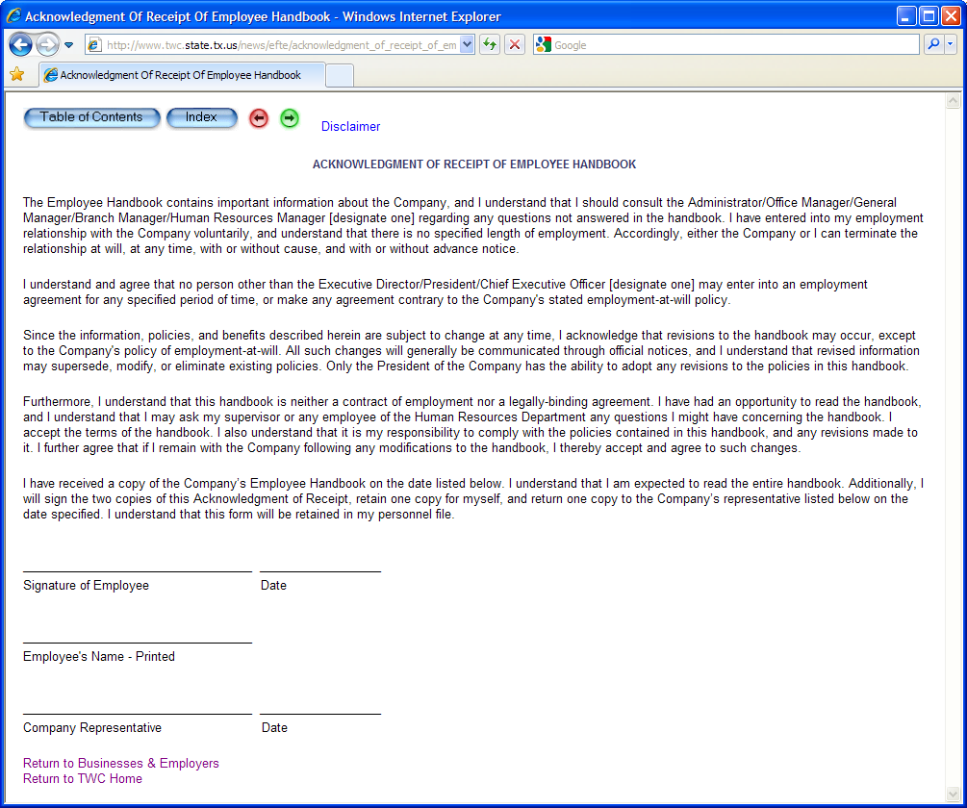
FIGURE 14–13 Handbook Acknowledgement Form
Notes:
Figure 14-13 shows an acknowledgment form that applicants can sign indicating that they have received and reviewed the employee handbook.

Slide 44
Personal Supervisory Liability
Avoiding Personal Supervisory Liability
  Be familiar with applicable statutes and know how to uphold their requirements.
  Follow company policies and procedures.
  Be consistent with application of rules or regulations.
  Don’t administer discipline in a manner that adds to the emotional hardship on the employee.
  Allow employees to tell their side of the story.
  Do not act in anger.
  Utilize the HR department for advice regarding how to handle difficult disciplinary matters.
Notes:
Courts sometimes hold managers personally liable for supervisory actions (including discipline and dismissal), particularly with respect to actions covered by the Fair Labor Standards Act and the Family and Medical Leave Act. The former defines employer to include “any person acting directly or indirectly in the interest of an employer in relation to any employee . . .” This can mean the individual supervisor.
This slide lists several ways managers can avoid personal liability.

Slide 45
The Termination Interview
Guidelines for the Termination Interview
1
Plan the interview carefully.
2
Get to the point.
3
Describe the situation.
4
Listen.
5
Review all elements of the severance package.
6
Identify the next step.
Notes:
Dismissing an employee is one of the most difficult tasks a manager faces at work. This slide lists guidelines for conducting the termination interview.

Slide 46
Termination Assistance
Outplacement Counseling
  A systematic process by which a terminated employee is trained and counseled in the techniques of conducting a self-appraisal and securing a new job appropriate to his or her needs and talents.
An offer of outplacement assistance:
  Does not imply that the employer takes responsibility
  for placing the person in a new job.
  Is part of the terminated employee’s support or severance package and is often done by specialized outside firms.
Notes:
Outplacement firms don’t just counsel displaced employees; they also help the employer devise its dismissal plan.

Slide 47
Termination Assistance (cont’d)
Outplacement Firms
  Can help the employer devise its dismissal plan regarding:
    How to break the news to dismissed employees.
    Dealing with dismissed employees’ emotional reactions.
    Instituting the appropriate severance pay and equal opportunity employment plans.
Notes:
Outplacement firms don’t just counsel displaced employees; they also help the employer devise its dismissal plan.

Slide 48
Interviewing Departing Employees
Exit Interview
  Its aim is to elicit information about the job or related matters that might give the employer a better insight into what is right—or wrong—about the company.
    The assumption is that because the employee is leaving, he or she will be candid.
    The quality of information gained from exit interviews is questionable.
Notes:
Many employers conduct exit interviews with employees who are leaving the firm for any reason. These are interviews, usually conducted by a human resource professional just prior to the employee leaving.

Slide 49
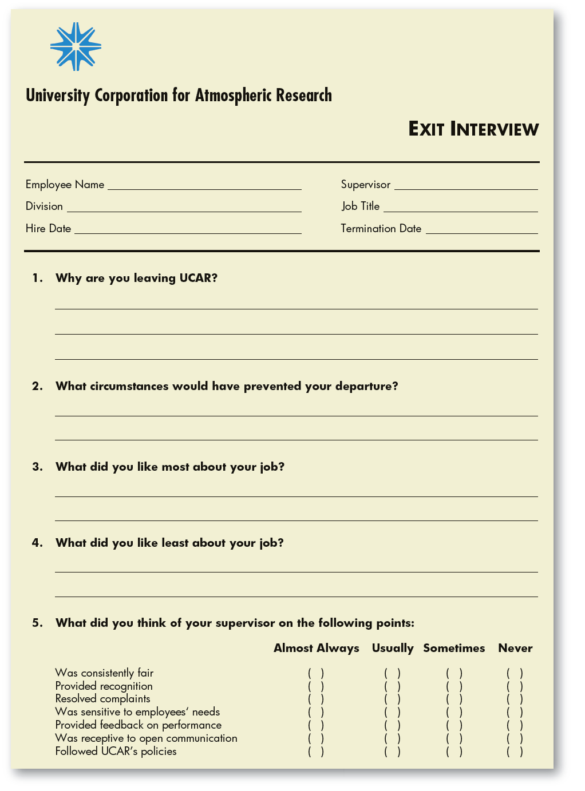
FIGURE 14–14
Employee Exit
Interview Questionnaire
Notes:
Figure 14-14 presents an exit interview form.

Slide 50
The Plant Closing Law
Worker Adjustment and Retraining Notification Act (1989)
  Requires employers of 100 or more employees to give 60 days’ notice before closing a facility or starting a layoff of 50 people or more.
  The law does not prevent the employer from closing down,
  nor does it require saving jobs.
  The law is intended to give employees time to seek other work or retraining by giving them advance notice of the shutdown.
Notes:
Until 1989, there were no federal laws requiring notification of employees when an employer decided to close a facility. The penalty for failing to give notice is one day’s pay and benefits to each employee for each day’s notice he or she should have received, up to 60 days.

Slide 51
The Layoff Process
Layoff Steps
  Identify objectives and constraints.
  Form a downsizing team.
  Address legal issues.
  Plan post-implementation actions.
  Address security concerns.
  Try to remain informative.
Notes:
Senior management must occasionally make strategic decisions about the size and timing of the layoffs. The steps to follow are listed in this slide.

Slide 52
Layoffs and Downsizing
Bumping/Layoff Procedures
  Seniority is usually the determinant of who will work.
  Seniority can give way to merit or ability.
  Seniority is usually based on the employee’s hiring date, not the date he or she took a particular job.
  Company-wide seniority allows an employee in one job to bump or displace an employee in another job.
Notes:
Employers who encounter frequent business slowdowns may have bumping/layoff procedures that let employees use their seniority to remain on the job (especially in unionized firms). Most such bumping/layoff procedures have the features listed in common.

Slide 53
Layoffs and Downsizing Alternatives
Voluntarily reducing employees’ pay
Concentrating employees’ vacations
Taking voluntary time off
Releasing temporary workers
Offering early retirement buyout packages
Notes:
Layoffs and downsizings are painful for all involved, and have the added disadvantage of stripping away trained personnel. Employers, therefore, often employ alternatives such as those listed in this slide.

Slide 54
Adjusting to Downsizings and Mergers
Guidelines for treatment of departing employees during a merger:
  Avoid the appearance of power and domination.
  Avoid win–lose behavior.
  Remain businesslike and professional.
  Maintain a positive feeling about the acquired company.
  Remember that how the organization treats the acquired group will affect those who remain.
Notes:
Firms usually downsize to improve their financial positions. Yet many firms discover profits don’t improve after major personnel cuts. Low morale among those remaining is often part of the problem.
It therefore makes sense to think through how the firm is going to reduce the surviving employees’ uncertainty and boost their morale.

Slide 55
K E Y T E R M S
ethics
distributive justice
procedural justice
organizational culture
ethics code
nonpunitive discipline
Electronic Communications Privacy Act (ECPA)
dismissal
termination at will
wrongful discharge
insubordination
termination interview
outplacement counseling
exit interviews
bumping/layoff procedures
downsizing

Slide 56
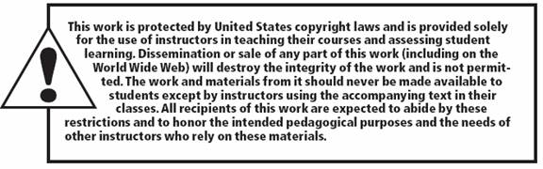
All rights reserved. No part of this publication may be reproduced, stored in a retrieval system, or transmitted, in any form or by any means, electronic, mechanical, photocopying, recording, or otherwise, without the prior written permission of the publisher. Printed in the United States of America.

